Slide 1
INST 414: Data Science Techniques Naïve Bayes

Slide 2
Intro to the Machine Learning Pipeline

Slide 3
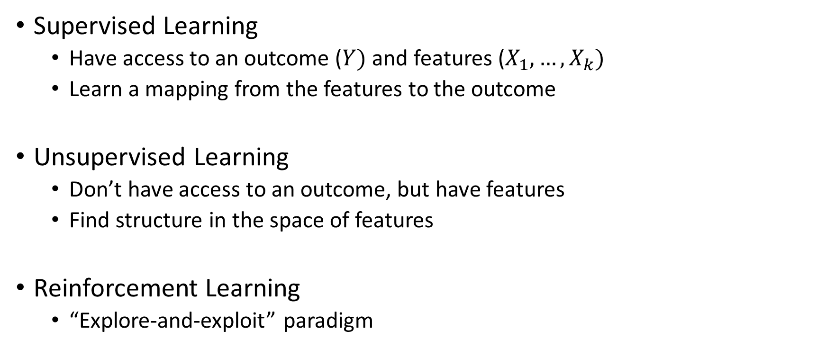
Different Types of Machine Learning
Supervised Learning
Have access to an outcome ($Y)$ and features ($X_{1},…,X_{k})$
Learn a mapping from the features to the outcome
Unsupervised Learning
Don’t have access to an outcome, but have features
Find structure in the space of features
Reinforcement Learning
“Explore-and-exploit” paradigm

Slide 4
Supervised Learning
Predict an outcome (or outcomes)
Types of outcomes
Binary (predicting re-arrest)
Multinomial (predicting what type of phone to recommend)
Continuous (predicting purchase price)
Structured (predicting what type of phone to recommend AND purchase price)

Slide 5
The Prediction Model Building Cycle
Clean Data
Define Outcome
Feature Generation
Evaluate
Train Model
Predict on Held-Out Data
Notes:
This assumes that

Slide 6
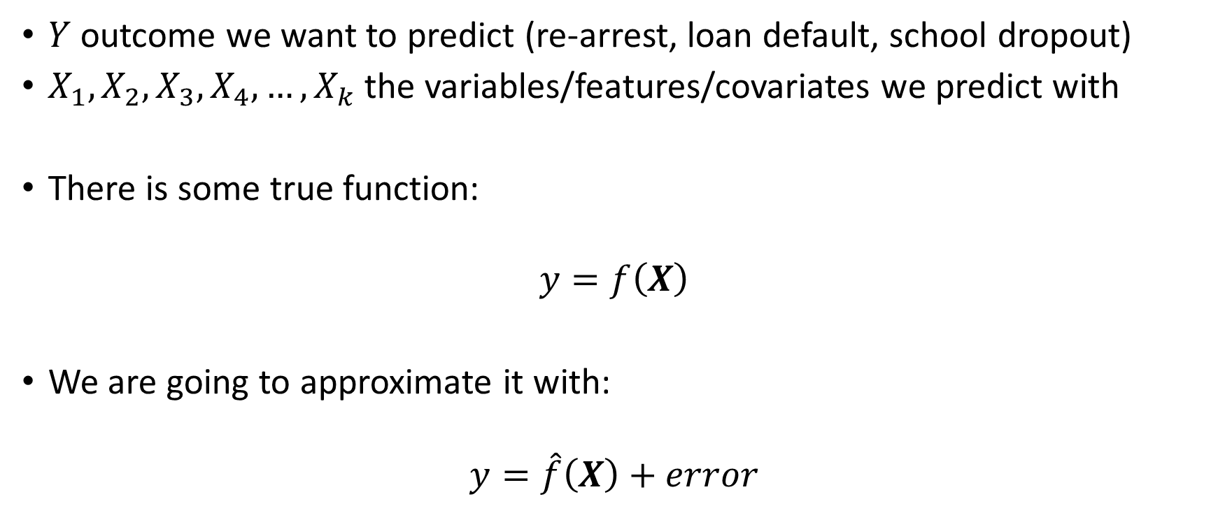
Model Training
$Y$ outcome we want to predict (re-arrest, loan default, school dropout)
$X_{1}, X_{2},X_{3},X_{4},…,X_{k}$the variables/features/covariates we predict with
There is some true function:
$$y=f\left(X\right)$$
We are going to approximate it with:
$$y=\hat{f}\left(X\right)+error$$

Slide 7
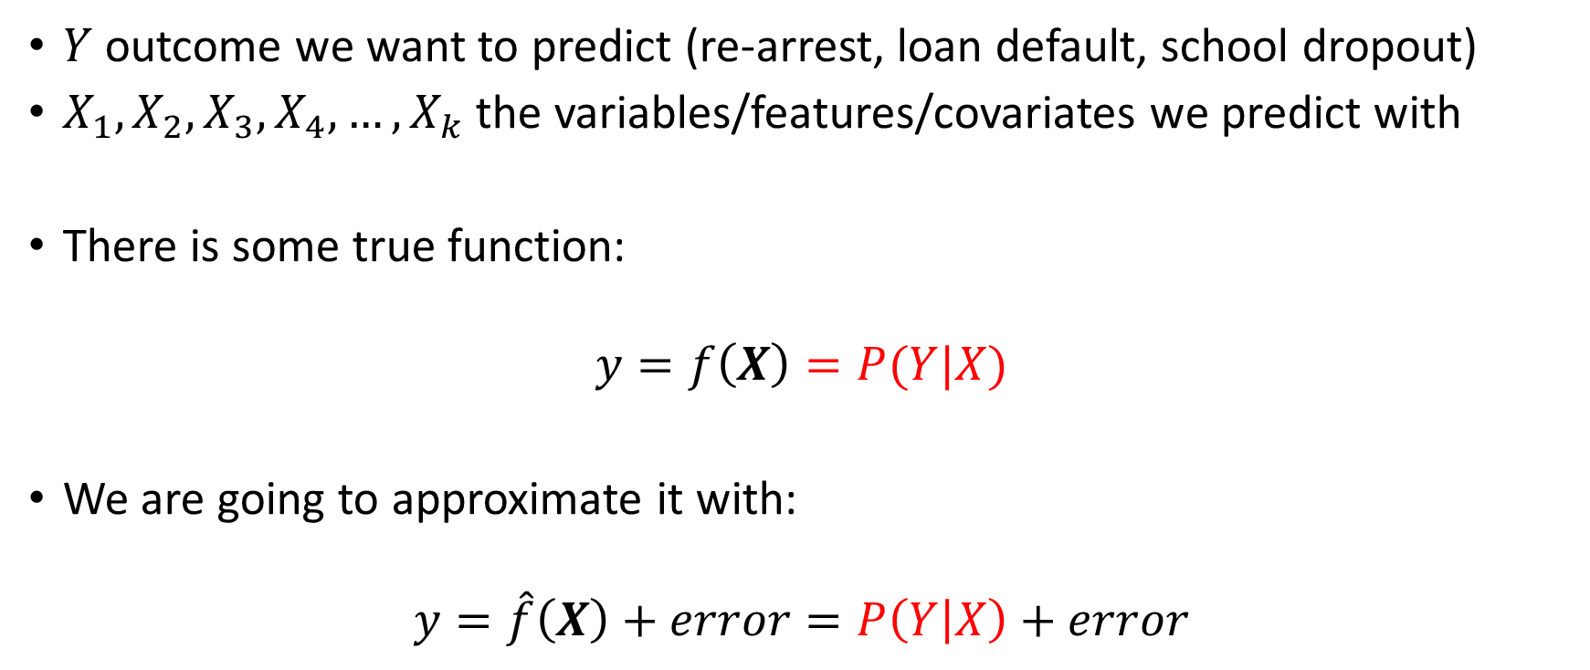
Model Training
$Y$ outcome we want to predict (re-arrest, loan default, school dropout)
$X_{1}, X_{2},X_{3},X_{4},…,X_{k}$the variables/features/covariates we predict with
There is some true function:
$$y=f\left(X\right)=P(Y|X)$$
We are going to approximate it with:
$$y=\hat{f}\left(X\right)+error=P\left(Y | X\right)+error$$

Slide 8
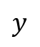

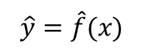
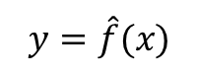
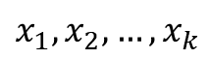
The Prediction Model Building Cycle
Clean Data
Define Outcome
$$x_{1},x_{2},…, x_{k}$$
$$y$$
Feature Generation
$$TPR$$
$$PPV$$
$$FPR$$
$$FNR$$
Evaluate
Train Model
$$y=\hat{f}(x)$$
Predict on Held-Out Data
$$\hat{y}=\hat{f}(x)$$
Notes:
This assumes that

Slide 9
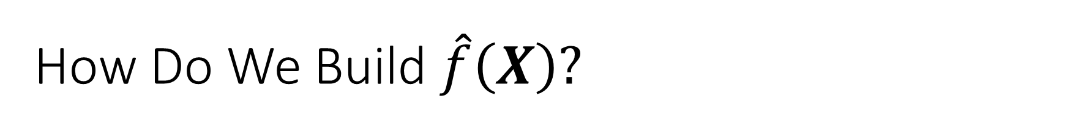
How Do We Build $\hat{f}\left(X\right)?$
Via machine learning algorithms (aka statistical learning models)
Examples:
Naïve Bayes
Linear Regression
Logistic Regression
Regularized Linear Regression (e.g. Lasso)
Random Forest
Gradient Boosting
Support Vector Machine
Neural Network/Deep Learning

Slide 10
Naïve Bayes

Slide 11
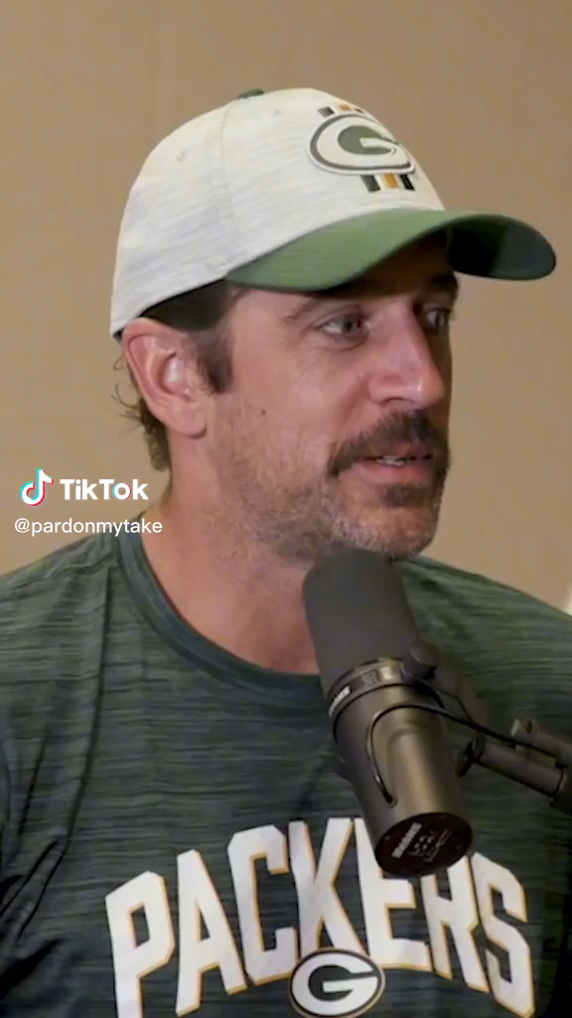
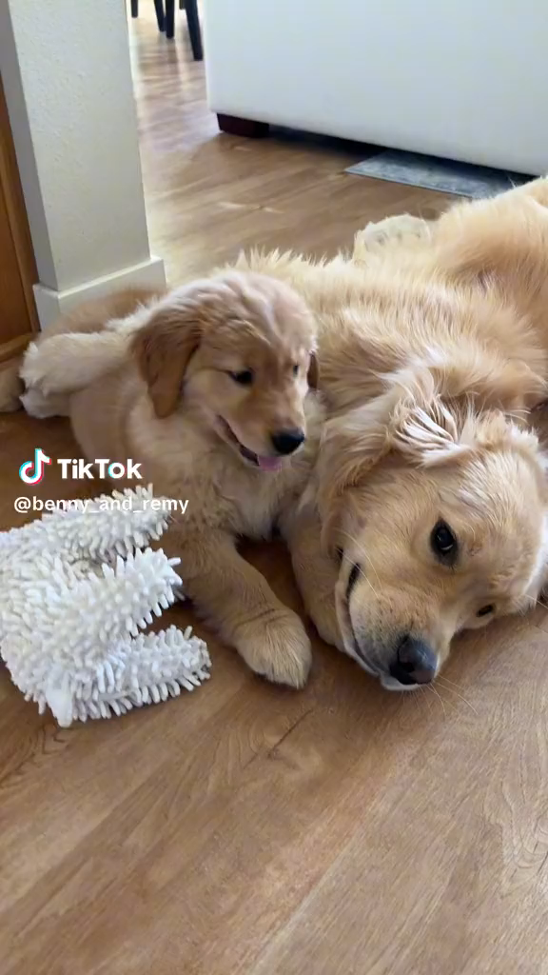
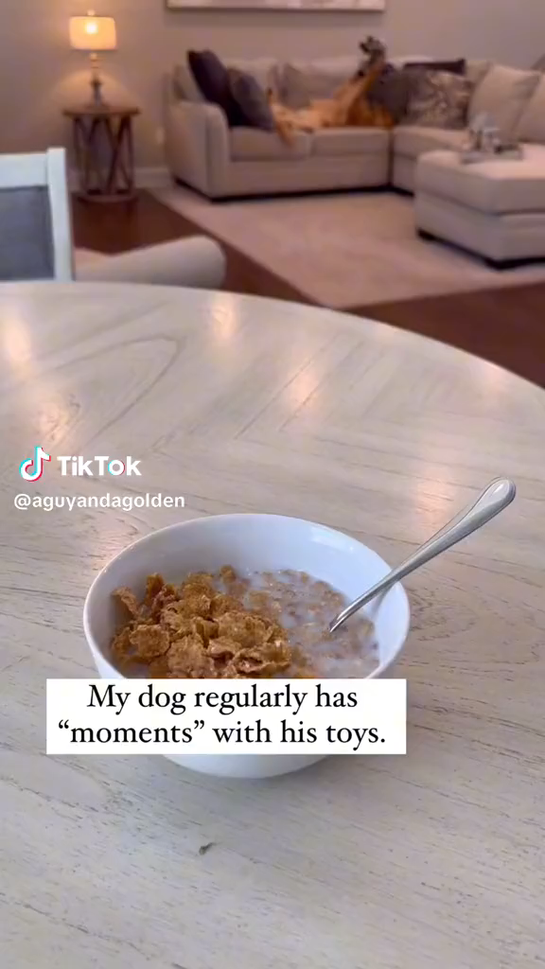
A prediction problem
Dog Videos
Sports Videos

Slide 12
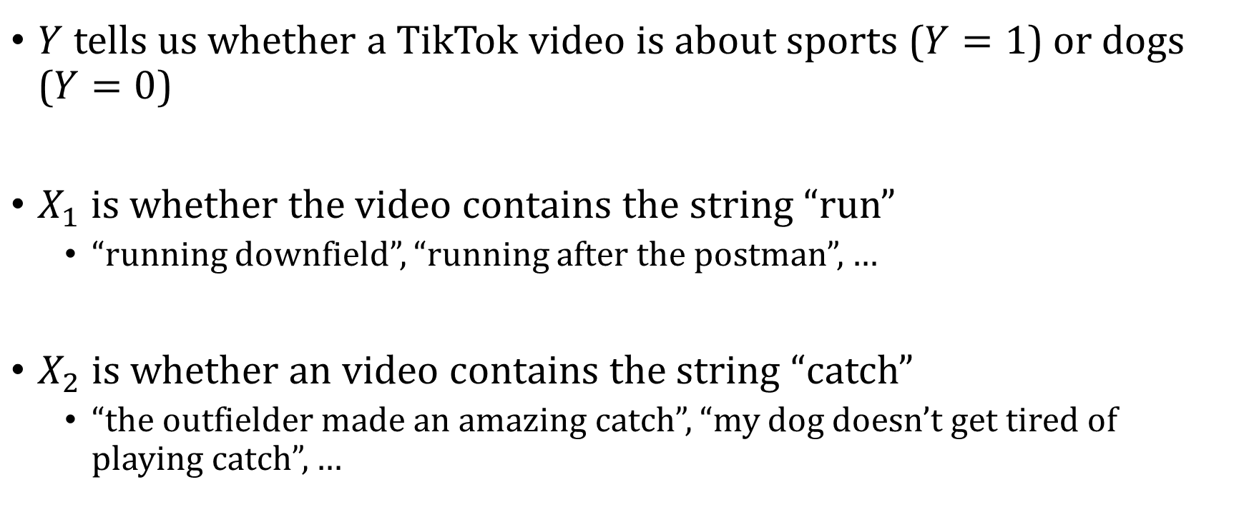
A prediction problem
$Y$ tells us whether a TikTok video is about sports ($Y=1$) or dogs ($Y=0$)
$X_{1}$ is whether the video contains the string “run”
“running downfield”, “running after the postman”, …
$X_{2}$ is whether an video contains the string “catch”
“the outfielder made an amazing catch”, “my dog doesn’t get tired of playing catch”, …

Slide 13
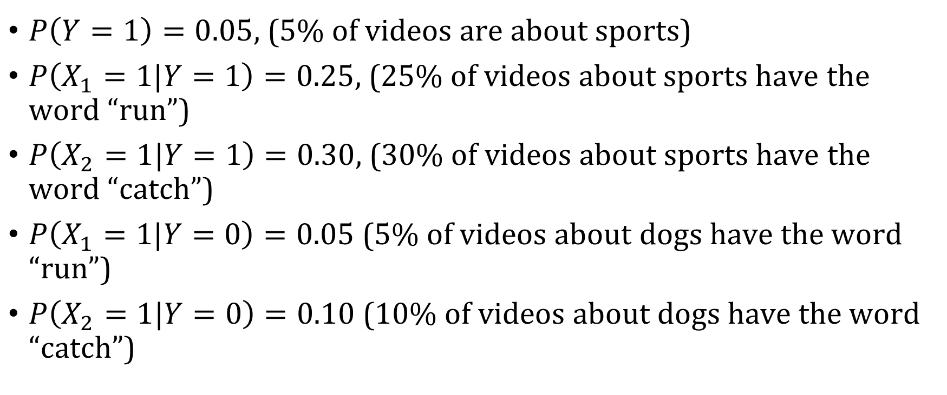
Estimates from the data
$P\left(Y=1\right)=0.05$, (5% of videos are about sports)
$P\left(X_{1}=1|Y=1\right)=0.25$, (25% of videos about sports have the word “run”)
$P\left(X_{2}=1|Y=1\right)=0.30$, (30% of videos about sports have the word “catch”)
$P\left(X_{1}=1|Y=0\right)=0.05$ (5% of videos about dogs have the word “run”)
$P\left(X_{2}=1|Y=0\right)=0.10$ (10% of videos about dogs have the word “catch”)

Slide 14
How should we classify a new video with the words “run” and “catch”?
$P\left(Y=1 | X_{1}=1,X_{2}=1\right)>P(Y=0|X_{1}=1, X_{2}=1 )$

Slide 15
How should we classify a new video with the words “run” and “catch”?
$$P\left(Y=1 | X_{1}=1,X_{2}=1\right)=\frac{P\left(X_{1}=1, X_{2}=1 , Y=1\right)}{P(X_{1}=1,X_{2}=1)}$$

Slide 16
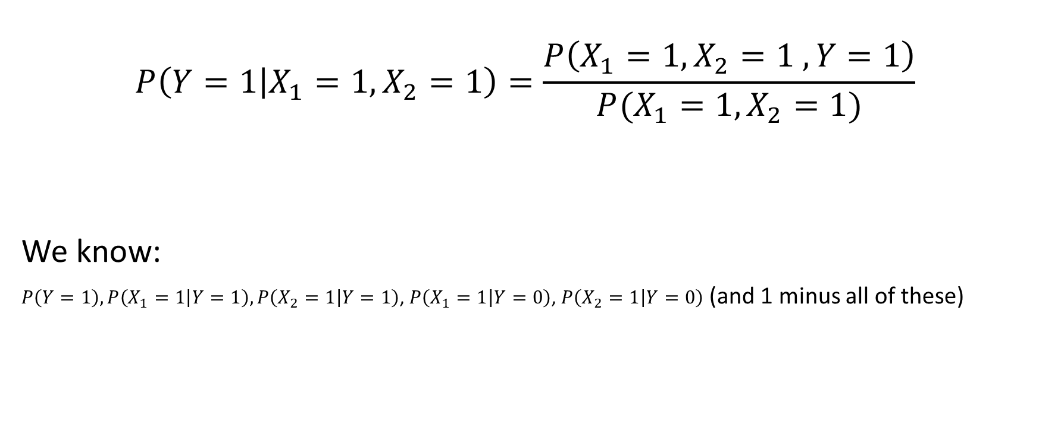
How should we classify a new video with the words “run” and “catch”?
$$P\left(Y=1 | X_{1}=1,X_{2}=1\right)=\frac{P\left(X_{1}=1, X_{2}=1 , Y=1\right)}{P(X_{1}=1,X_{2}=1)}$$
We know:
$P\left(Y=1\right), P\left(X_{1}=1 | Y=1\right),P\left(X_{2}=1 | Y=1\right)$, $P\left(X_{1}=1 | Y=0\right)$, $P\left(X_{2}=1 | Y=0\right)$ (and 1 minus all of these)

Slide 17
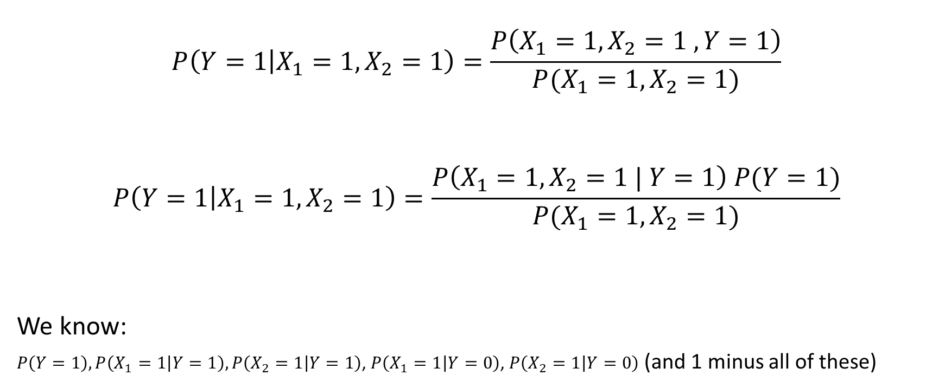
How should we classify a new video with the words “run” and “catch”?
$$P\left(Y=1 | X_{1}=1,X_{2}=1\right)=\frac{P\left(X_{1}=1, X_{2}=1 , Y=1\right)}{P(X_{1}=1,X_{2}=1)}$$
$$P\left(Y=1 | X_{1}=1,X_{2}=1\right)=\frac{P\left(X_{1}=1, X_{2}=1 | Y=1\right) P(Y=1)}{P(X_{1}=1,X_{2}=1)}$$
We know:
$P\left(Y=1\right), P\left(X_{1}=1 | Y=1\right),P\left(X_{2}=1 | Y=1\right)$, $P\left(X_{1}=1 | Y=0\right)$, $P\left(X_{2}=1 | Y=0\right)$ (and 1 minus all of these)

Slide 18
Independence
Recall that two random variables are independent if the following holds:
$P\left(A, B\right)=P\left(A\right) P(B)$

Slide 19
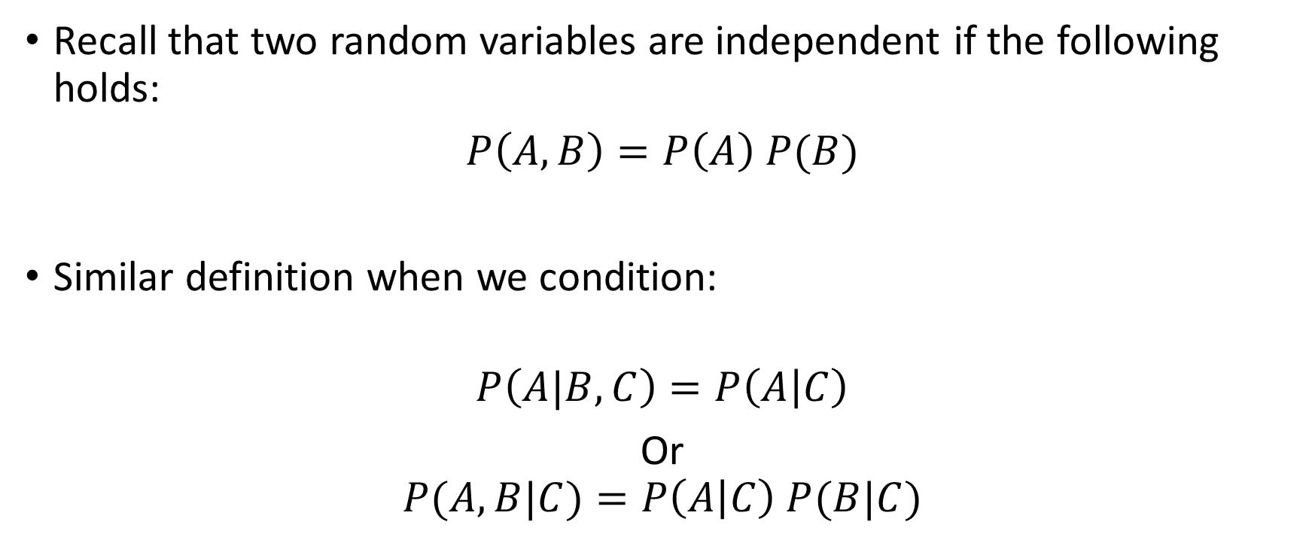
Conditional Independence
Recall that two random variables are independent if the following holds:
$P\left(A, B\right)=P\left(A\right) P(B)$
Similar definition when we condition:
$$P\left(A|B,C\right)=P\left(A | C\right)$$
Or
$$P(A,B|C)=P\left(A | C\right) P(B|C)$$

Slide 20
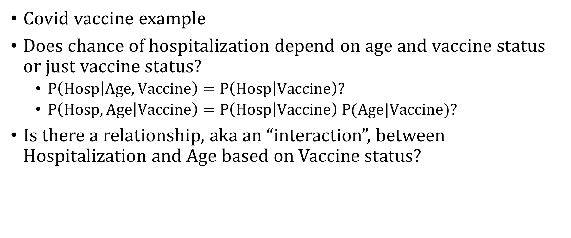
Conditional Independence Intuition
Covid vaccine example
Does chance of hospitalization depend on age and vaccine status or just vaccine status?
$P\left(Hosp | Age, Vaccine\right)=P\left(Hosp | Vaccine\right)?$
$P\left(Hosp,Age | Vaccine\right)=P\left(Hosp | Vaccine\right) P(Age|Vaccine)?$
Is there a relationship, aka an “interaction”, between Hospitalization and Age based on Vaccine status?

Slide 21
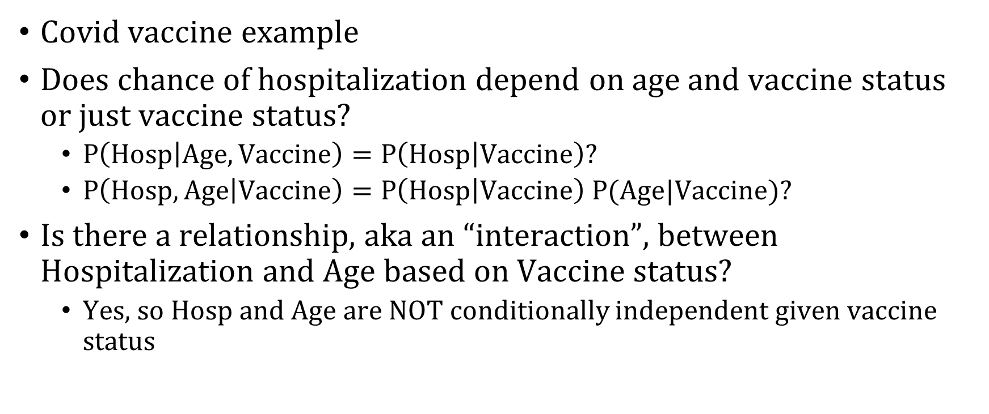
Conditional Independence Intuition
Covid vaccine example
Does chance of hospitalization depend on age and vaccine status or just vaccine status?
$P\left(Hosp | Age, Vaccine\right)=P\left(Hosp | Vaccine\right)?$
$P\left(Hosp,Age | Vaccine\right)=P\left(Hosp | Vaccine\right) P(Age|Vaccine)?$
Is there a relationship, aka an “interaction”, between Hospitalization and Age based on Vaccine status?
Yes, so Hosp and Age are NOT conditionally independent given vaccine status

Slide 22
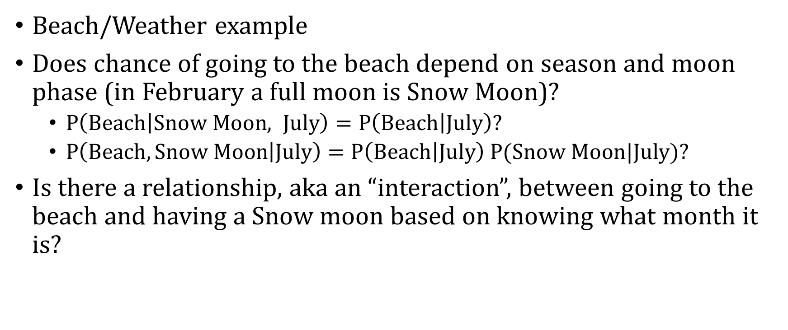
Conditional Independence Intuition
Beach/Weather example
Does chance of going to the beach depend on season and moon phase (in February a full moon is Snow Moon)?
$P\left(Beach | Snow Moon, July\right)=P\left(Beach | July\right)?$
$P\left(Beach,Snow Moon | July\right)=P\left(Beach | July\right) P(Snow Moon|July)?$
Is there a relationship, aka an “interaction”, between going to the beach and having a Snow moon based on knowing what month it is?

Slide 23
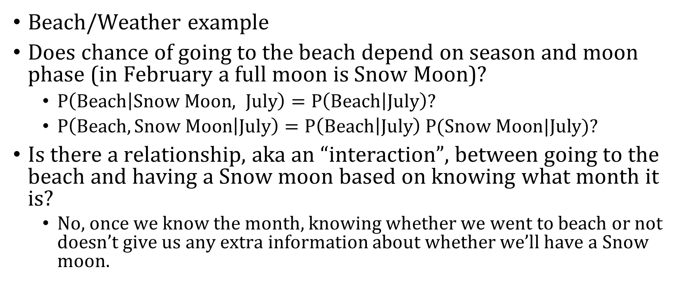
Conditional Independence Intuition
Beach/Weather example
Does chance of going to the beach depend on season and moon phase (in February a full moon is Snow Moon)?
$P\left(Beach | Snow Moon, July\right)=P\left(Beach | July\right)?$
$P\left(Beach,Snow Moon | July\right)=P\left(Beach | July\right) P(Snow Moon|July)?$
Is there a relationship, aka an “interaction”, between going to the beach and having a Snow moon based on knowing what month it is?
No, once we know the month, knowing whether we went to beach or not doesn’t give us any extra information about whether we’ll have a Snow moon.

Slide 24
Naïve Bayes Assumption
$$P\left(Y=1 | X_{1}=1,X_{2}=1\right)=\frac{P\left(X_{1}=1, X_{2}=1 | Y=1\right) P(Y=1)}{P(X_{1}=1,X_{2}=1)}$$

Slide 25
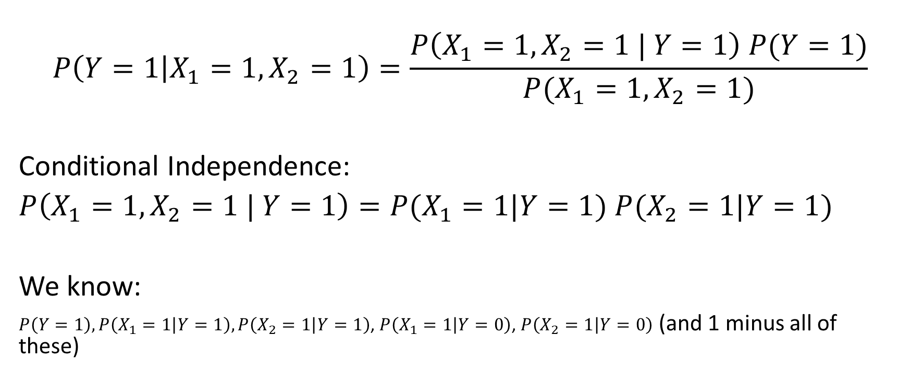
Naïve Bayes Assumption
$$P\left(Y=1 | X_{1}=1,X_{2}=1\right)=\frac{P\left(X_{1}=1, X_{2}=1 | Y=1\right) P(Y=1)}{P(X_{1}=1,X_{2}=1)}$$
Conditional Independence:
$P\left(X_{1}=1, X_{2}=1 | Y=1\right)=P(X_{1}=1|Y=1)$ $P(X_{2}=1|Y=1)$
We know:
$P\left(Y=1\right), P\left(X_{1}=1 | Y=1\right),P\left(X_{2}=1 | Y=1\right)$, $P\left(X_{1}=1 | Y=0\right)$, $P\left(X_{2}=1 | Y=0\right)$ (and 1 minus all of these)

Slide 26
Let’s Compute $P\left(Y=1 | X_{1}=1,X_{2}=1\right)$
$$P\left(Y=1 | X_{1}=1,X_{2}=1\right)=\frac{P\left(X_{1}=1, X_{2}=1 , Y=1\right)}{P(X_{1}=1,X_{2}=1)}$$
$$P\left(Y=1 | X_{1}=1,X_{2}=1\right)=\frac{P\left(X_{1}=1, X_{2}=1 | Y=1\right) P(Y=1)}{P(X_{1}=1,X_{2}=1)}$$
$$P\left(Y=1 | X_{1}=1,X_{2}=1\right)=\frac{P\left(X_{1}=1\left|Y=1\right)P(X_{2}=1 | Y=1\right) P(Y=1)}{P(X_{1}=1,X_{2}=1)}$$

Slide 27
Let’s Compute $P\left(Y=1 | X_{1}=1,X_{2}=1\right)$
$$P\left(Y=1 | X_{1}=1,X_{2}=1\right)=\frac{P\left(X_{1}=1\left|Y=1\right)P(X_{2}=1 | Y=1\right) P(Y=1)}{P(X_{1}=1,X_{2}=1)}$$
$P\left(Y=1 | X_{1}=1,X_{2}=1\right)=\frac{0.25 ∗0.3 ∗0.05}{P(X_{1}=1,X_{2}=1)}=\frac{0.00375}{P(X_{1}=1, X_{2}=2)}$

Slide 28
Let’s Compute $P\left(Y=1 | X_{1}=1,X_{2}=1\right)$
$$P\left(Y=1 | X_{1}=1,X_{2}=1\right)=\frac{P\left(X_{1}=1\left|Y=1\right)P(X_{2}=1 | Y=1\right) P(Y=1)}{P(X_{1}=1,X_{2}=1)}$$
$P\left(Y=1 | X_{1}=1,X_{2}=1\right)=\frac{0.25 ∗0.3 ∗0.05}{P(X_{1}=1,X_{2}=1)}=\frac{0.00375}{P(X_{1}=1, X_{2}=2)}$
But what if $P\left(Y=1 | X_{1}=1,X_{2}=1\right)<P\left(Y=0 | X_{1}=1,X_{2}=1\right)$?

Slide 29
Let’s Compute $P\left(Y=0 | X_{1}=1,X_{2}=1\right)$
$$P\left(Y=0 | X_{1}=1,X_{2}=1\right)=\frac{P\left(X_{1}=1\left|Y=0\right)P(X_{2}=1 | Y=0\right) P(Y=0)}{P(X_{1}=1,X_{2}=1)}$$
$P\left(Y=0 | X_{1}=1,X_{2}=1\right)=\frac{0.05 ∗0.1 ∗0.95}{P(X_{1}=1,X_{2}=1)}=\frac{0.00475}{P(X_{1}=1, X_{2}=2)}$

Slide 30
What’s our decision rule?
$\frac{.00375}{P\left(X_{1}=1,X_{2}=1\right)} \text{vs}\text{.} \frac{.00475}{P\left(X_{1}=1,X_{2}=1\right)}$

Slide 31
What’s our decision rule?
$\frac{.00375}{P\left(X_{1}=1,X_{2}=1\right)} \text{vs}\text{.} \frac{.00475}{P\left(X_{1}=1,X_{2}=1\right)}$

Slide 32
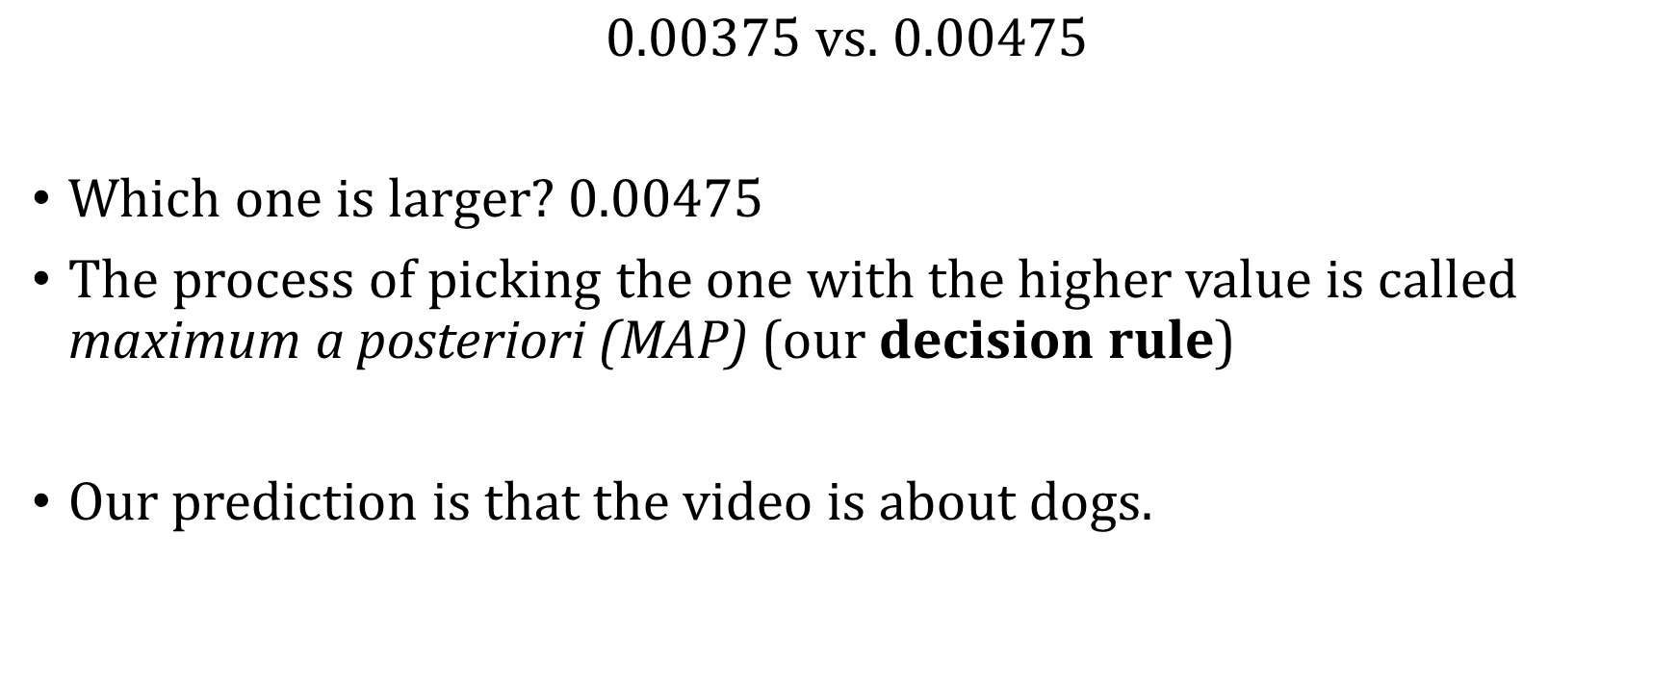
What’s our decision rule?
$0.00375 \text{vs}\text{.} 0.00475$
Which one is larger? 0.00475
The process of picking the one with the higher value is called maximum a posteriori (MAP) (our decision rule)
Our prediction is that the video is about dogs.

